Slide 1
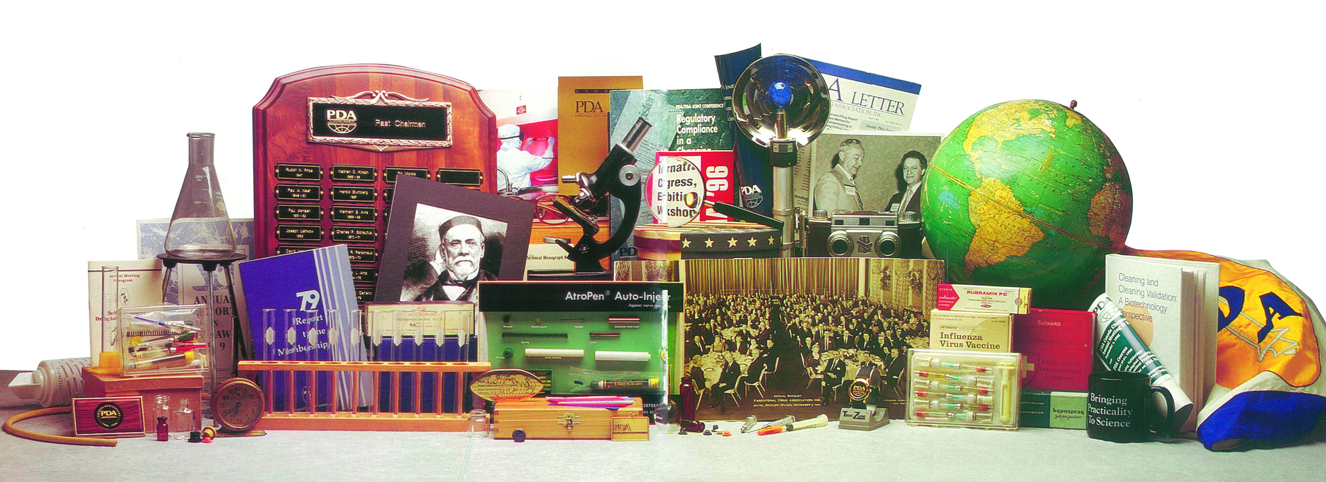
77 Years of Service to Our Members

Slide 2
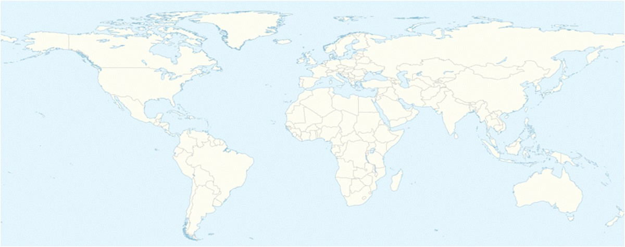
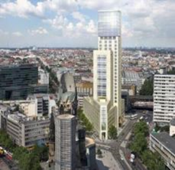
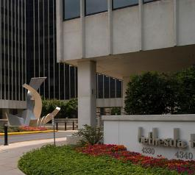

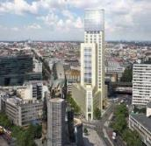
Global Offices &
Chapters
PDA Europe
Berlin, Germany
Bethesda, MD
PDA Global HQ
Bethesda, MD USA
PDA Asia Pacific
Singapore
26 Chapters
Around the Globe

Slide 3
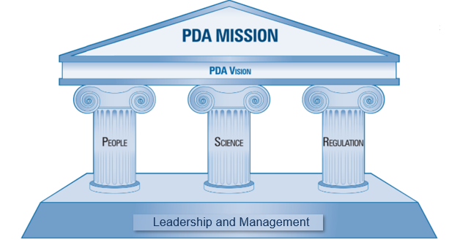
Mission:
Advance pharmaceutical/ biopharmaceutical manufacturing science and regulation so members can better serve patients
Vision:
To maximize product quality, availability, and value by connecting people, science, and regulation within the pharmaceutical and biopharmaceutical community
Connecting People, Science and Regulation®

Slide 4
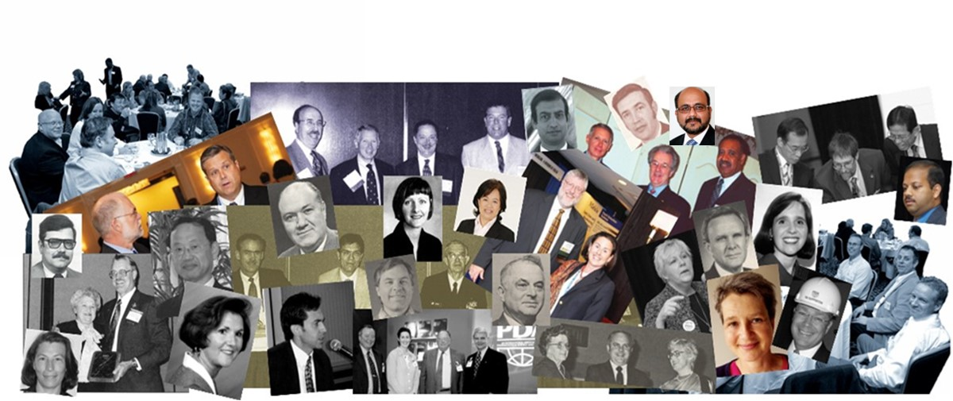
Open to All who Wish to Join
Fully Non-Profit (No Affiliate or Subordinate For-Profit Organizations)

Slide 5

Member Focused
Serving our Members and the Industry Since 1946
As an individual membership only organization, our members chart our course through their involvement in:
Meetings
Task Forces
Advisory Boards
Steering Committees
and the Board of Directors
Our members decide what PDA will work on and the position PDA will take on topics that they identify as important for our industry

Slide 6
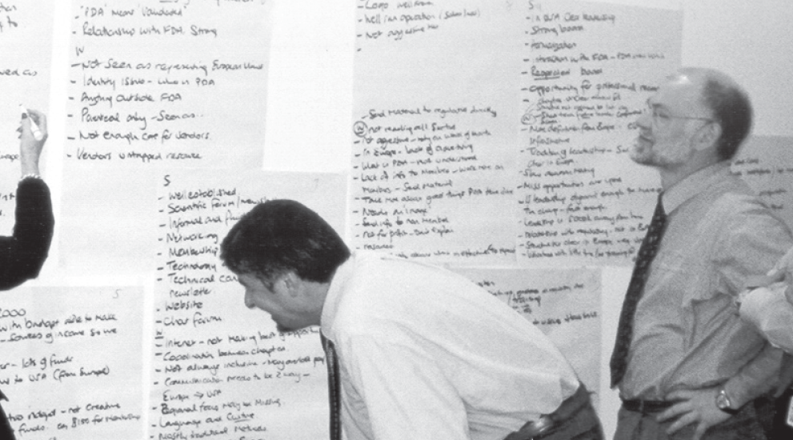
By design we provide an Independent Voice for our Membership, always Based in Science
PDA provides a framework in which our members come together and discuss and debate topics of importance to the industry
Allowing our members voices be heard through our many conference, surveys, technical reports, PDA Letter articles, regulatory comments, meetings with regulators, etc.
The Voice of PDA is that of our Members

Slide 7
PDA Mission
To advance pharmaceutical/ biopharmaceutical manufacturing science and regulation so members can better serve patients.

Slide 8
Focused on Advocacy & Outreach
Leading global provider of Science, Technology, and Regulatory Information
Driving Scientific Consensus
Engagement with Regulators
Sharing Knowledge
Development of Technical Reports, Research, Standards
Joint Regulatory Conferences
World leading conferences
Training Partnerships (PIC/S, ICH)
Renowned training
Regulatory Participation
Regulatory Comments
Publications
Collaborations (A3P, PQRI, AAMI, PMF, SCB, IPEC, Kilmer, etc.)
Regulators: members, participants and reviewers
Chapters, Interest Groups, and platforms for exchange

Slide 9
PDA Vision
To maximize product quality, availability, and value by connecting people, science, and regulation within the pharmaceutical and biopharmaceutical community so that PDA is:
The preferred choice for professionals who seek specialized, innovative skills and knowledge enhancing their professional development
The premier educational partner for professionals in academia, industry, and government for the advancement of manufacturing, quality, and regulatory science
An organization that aligns its practices and resources in support of its core values of a basis in science (science based), integrity, and inclusion

Slide 10



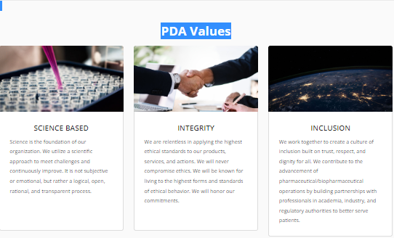
PDA Values
SCIENCE BASED
Science is the foundation of our organization. We utilize a scientific approach to meet challenges and continuously improve. It is not subjective or emotional, but rather a logical, open, rational, and transparent process.
INTEGRITY
We are relentless in applying the highest ethical standards to our products, services, and actions. We will never compromise ethics. We will be known for living to the highest forms and standards of ethical behavior. We will honor our commitments.
INCLUSION
We work together to create a culture of inclusion built on trust, respect, and dignity for all. We contribute to the advancement of pharmaceutical/biopharmaceutical operations by building partnerships with professionals in academia, industry, and regulatory authorities to better serve patients.

Slide 11

Strategic Plan Summary 2020-2026
Premier global leader in advancing science, manufacturing, quality and innovation
Enable global regulatory harmonization and industry standards
Enhance value by growing and improving globally
Grow global membership
Increase membership diversity
Global access to services and products
Deliver value to members
Retain and advance core expertise
Proactively respond to trends and innovation
Expand PDA’s applied research
Explore and advance partnerships
Regulatory monitoring and training
Advocacy and engagement
Establish industry standards
PEOPLE
SCIENCE
REGULATION

Slide 12
Key Association Initiatives
Enhance communication and opportunities for Early Career Professionals (ECPs)
Create expanded opportunities for volunteers and improve entry process
Engage HAs and industry leaders on important topics to drive consensus
Create a hot topic/trend repository to guide PDA focus
Develop a library of on-demand basic training modules
Support regulatory harmonization towards technology acceptance
Continue to drive towards diversity in all PDA activities
Expand the activities of the PDA Foundation

Slide 13
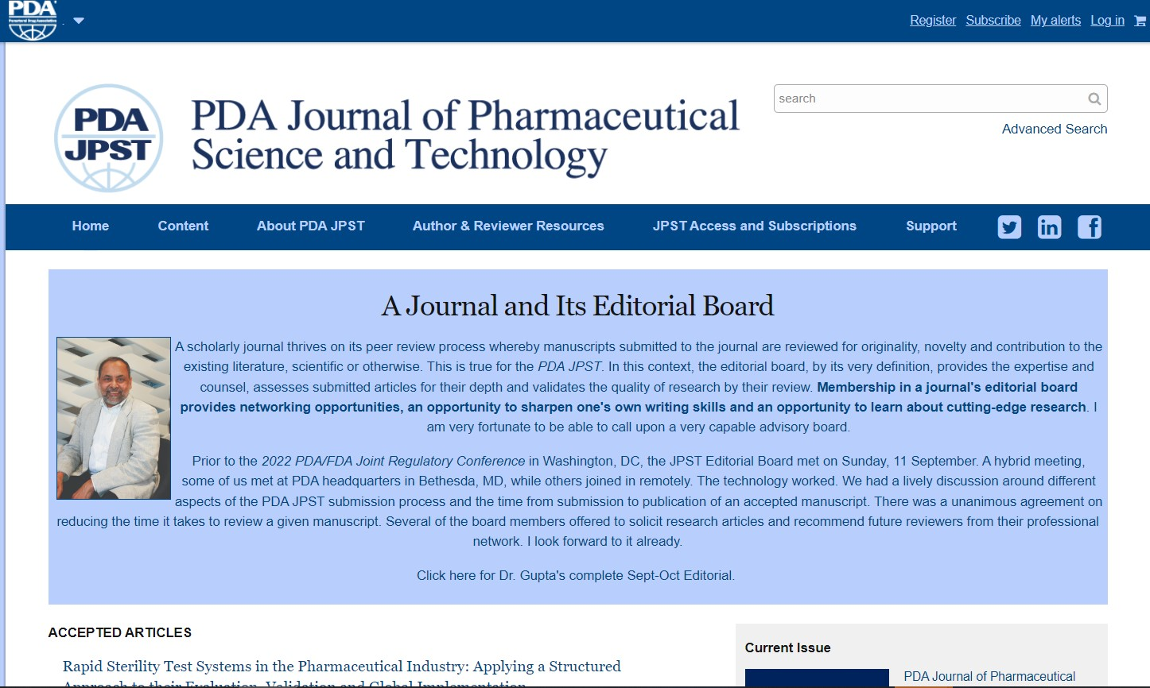
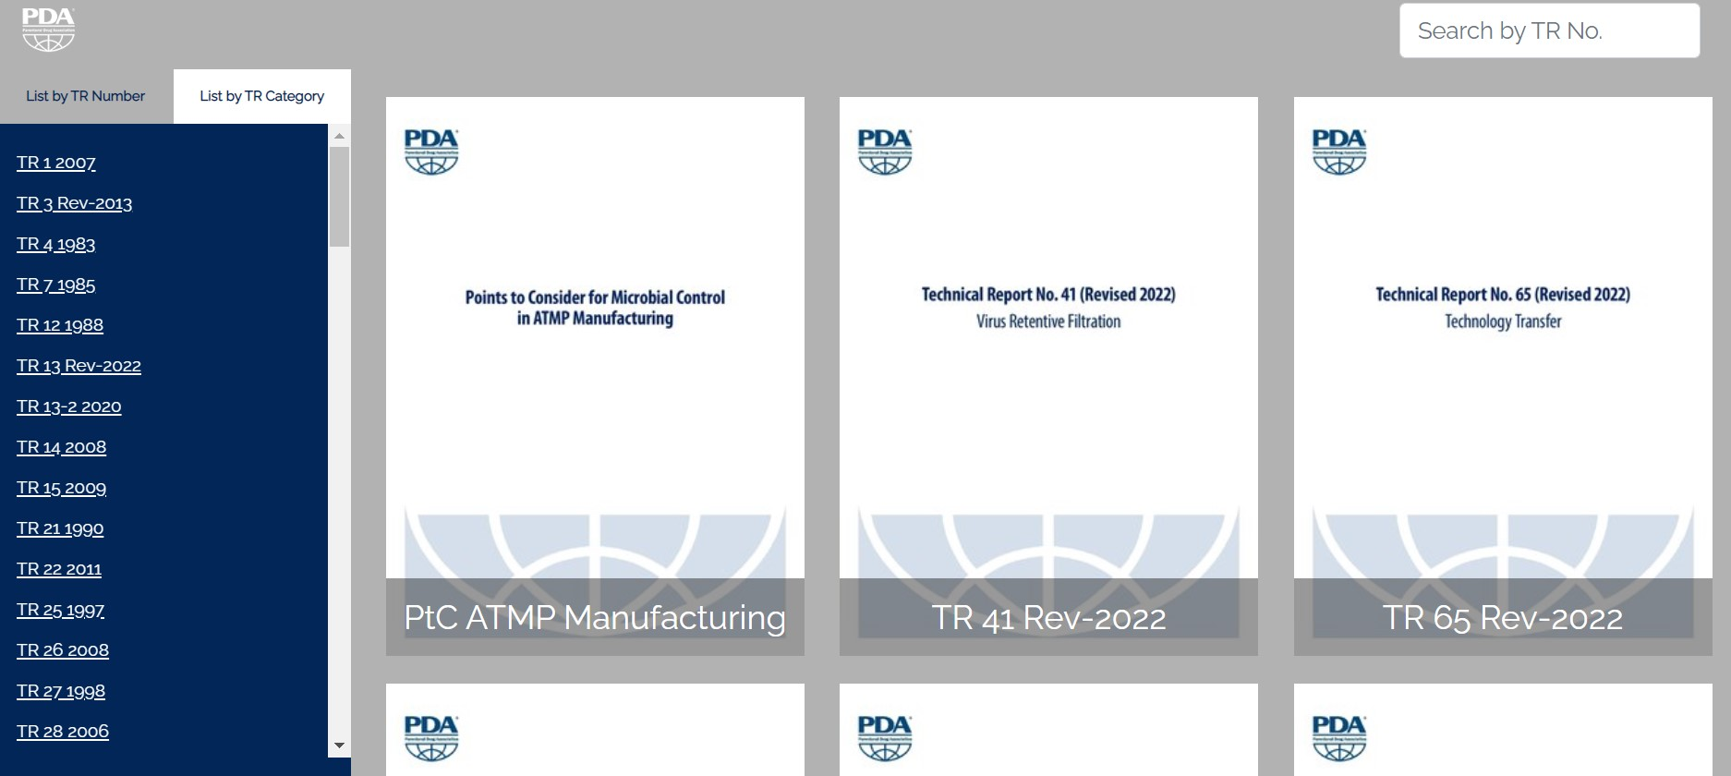
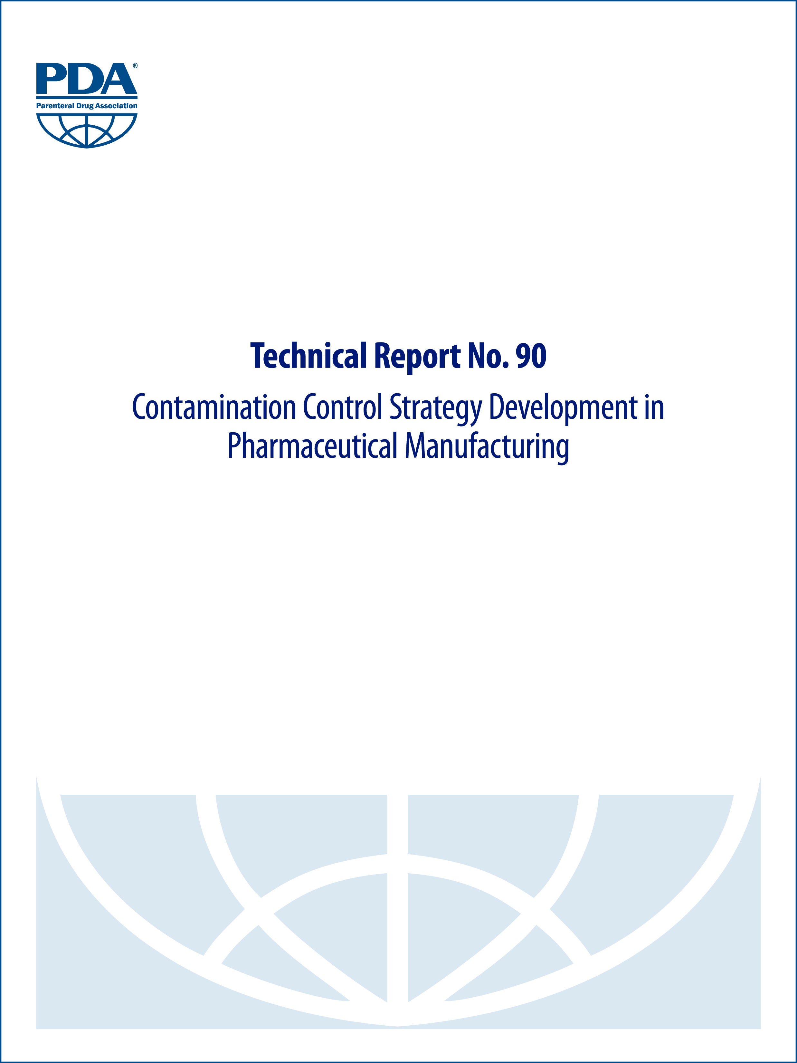

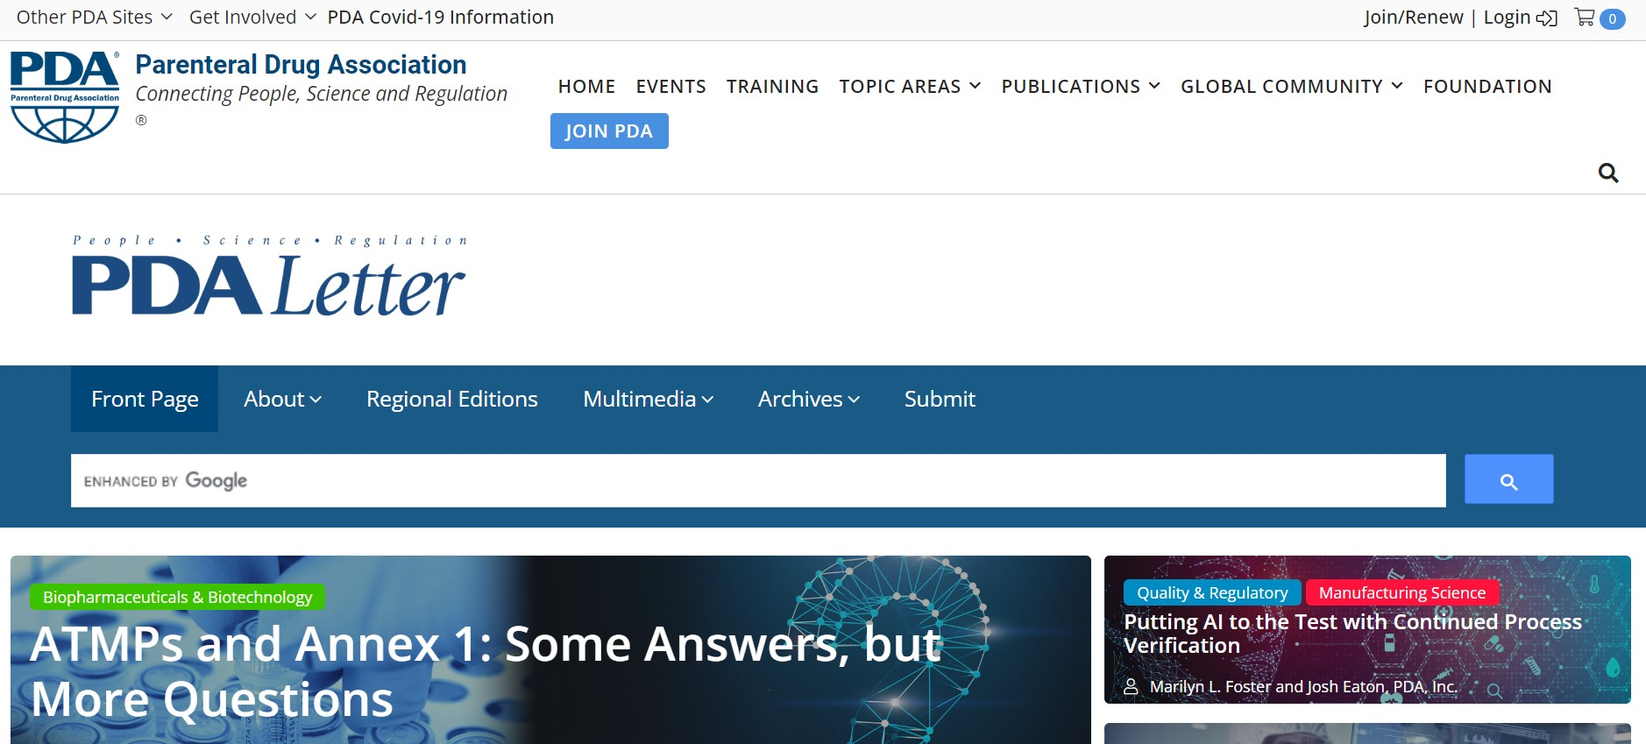
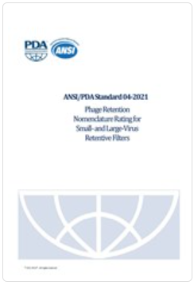
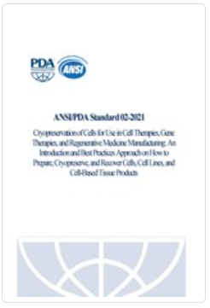
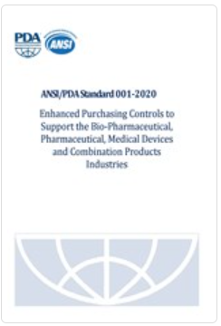
Major PDA Publications
PDA Journal of Pharmaceutical Science and Technology
Technical Reports, Points to Consider, Surveys
PDA Letter
Consensus Standards
Notes:
PDA Journal of Science and Technology
PDA Letter
PDA Technical Reports – Download or access via Technical Report Portal
13

Slide 14
World Renowned Training
Hands-on and Lecture based training provided at the PDA’s Training Research Institute in the United States and locations across the Globe
Over 22,000 industry members and regulators trained since 2009
New courses being developed on an ongoing basis to meet the needs of our members and the wider industry
Notes:
Partnered or provided training to these organizations

Slide 15
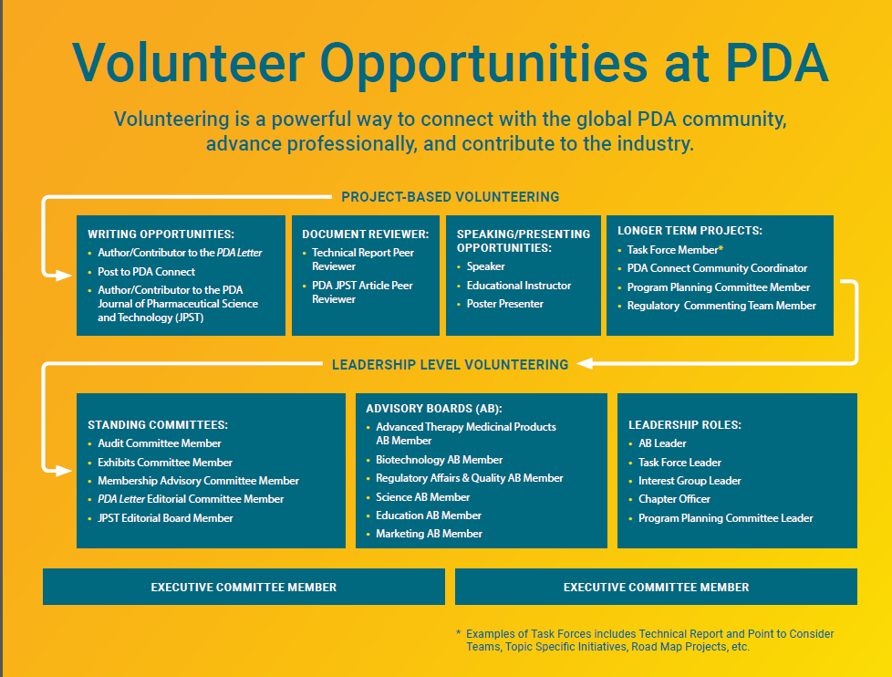

Slide 16
New Membership Tiers Structure
More Options for Members to Chose

Slide 17
Summary of Major Accomplishments
Added 6 new Chapters
Hosted more than 55,000 attendees at 440+ Conferences and workshops
Trained more than 22,000 individuals worldwide
Published more than 110 PDA technical publications
Commented on hundreds of regulatory documents
Expanded our facilities in TRI and offices
Added Asia Pacific Office
Since 2009, PDA has:

Slide 18




UPCOMMING EVENTS

Slide 19
PDA Contact Info:
Global HQ
PDA Member Relations
4350 East West Hwy. Suite 600, Bethesda, MD 20814 USA
info@pda.org or +1-301-656-5900
PDA Europe
Am Borsigturm 60
13507 - Berlin, Germany
Tel: +49 30 436 55 08-0 or -10
PDA Asia Pacific
20 Bendemeer Rd, #04-02 BS Bendemeer Centre Singapore 339914
Tel: +65 64965504
Notes:
19

