Slide 2
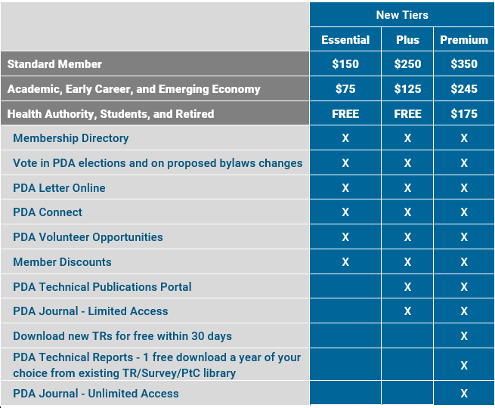
The PDA Membership Structure Has Changed!
PDA is excited to provide a flexible membership structure, now available!
Visit www.pda.org/membership/new-membership-structure for details and the answers to Frequently Asked Questions.
Here is a snapshot of how the tiers are structured:

Slide 3
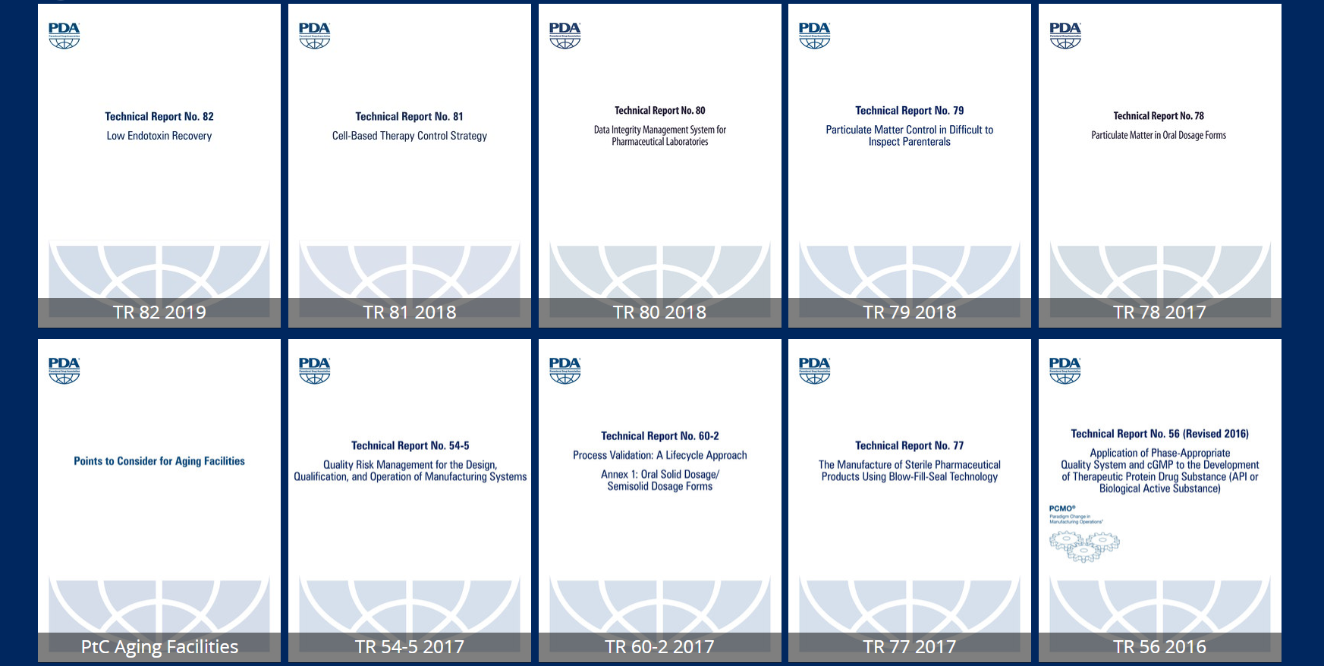
PDA Technical Document Portal
PDA Plus and Premium Members have 24/7 access to more than 70 active technical resources in the PDA Portal.

Slide 5
